Slide 1
Nutri soil
TEAM LEADER : PULLAIAHGARI LAHARI
INSTITUTE
GURU NANAK INTITUTE OF TECHNOLOGY
IDEA DOMAIN: AGRICULTURE
IDEA : INDENTIFICATION OF
NUTRIENTS REQUIRED
FOR THE SOIL

Slide 2
IDEA DETAILS
Agriculture, with its allied sectors, is unquestionably the largest livelihood provider in india,more so in the vast rural areas.It also contributes a significant value to the gross domestic product(GDP).Development in agriculture will help in upliftment of farmers and also inturn India.
But due to soil discrimination/misuse and imbalanced soil fertilizer use,Indian soil shows deficiency of nutrients. Adding inappropriate amount of pesticides and fertilizers to the soil in the expectation of good yield can alter the natural cycling of nutrients in the soil.
We have designed a solution to find the exact amount of nutrients required for the soil which can reduce the degradation of soil quality.

Slide 3
Land in india
1970
2010

Slide 4
Solution
Hence we proposed an idea that advices the amount of pesticides and fertilizers to be used and gives information to the farmer about the nutrients in the soil
This application/idea also suggest the next crop to be grown which gives profit and also provides nutrients to the soil for different crops.
This also gives information about the organic fertilizers used for the soil instead of additional usage of inorganic fertilizers.

Slide 5
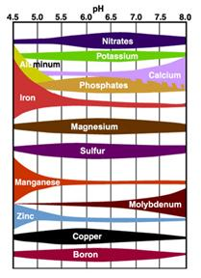
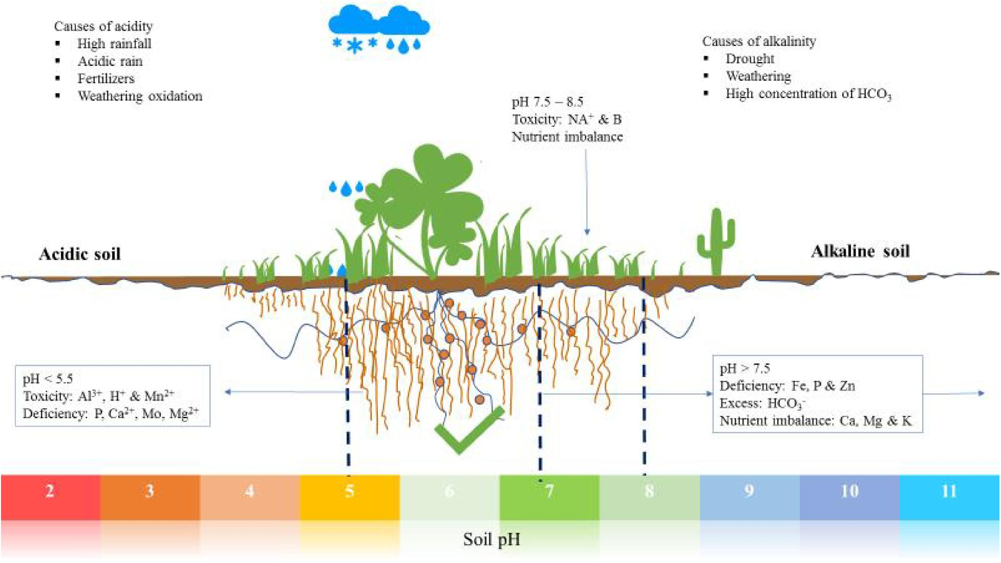
SOIL TESTING
Depending upon the pH value of the soil the nutrients are determined.Depending upon the
nutrients value the usage and type of
fertilizers and pesticides vary.

Slide 6
Steps for designing
Interpret result
analyzing the data
Presenting my ideas and goals
Collecting data of the nutrients based on pH values
Cleaning the unwanted data

Slide 7

EXECUTION CYCLE
Collecting soil
Conducting pH test
Entering pH values in application
Usage of fertilizers depending on output
Less investment and better yield

Slide 8
BENIFITS
This application gives information to the farmers about usage of the specific fertilizers
This prevents from disturbing the natural cycle of the soil.
This also prevents the water from being polluted by the fertilizers which can also have indirect effects on humans.
The proper nutrients help the crop in growth and also gives better result.

Slide 9
Thankyou
My special thanks to my teachers and my parent who have been supporting me .
Also I wanted to express my special thanks to the farmers working out there.

